Slide 1


Safety and efficacy testing of experimental ASF vaccines: what we have learned from the pigs
Jishu Shi
Professor of Vaccine Immunology
Director, Center for Vaccine Evaluation
Dr. Wayne & Hilda Appleton Endowed Professor
Vanier & Krause Fellow, Biosecurity Research Institute
Director, U.S.-China Center for Animal Health
College of Veterinary Medicine, Kansas State University, Manhattan, Kansas

Slide 2
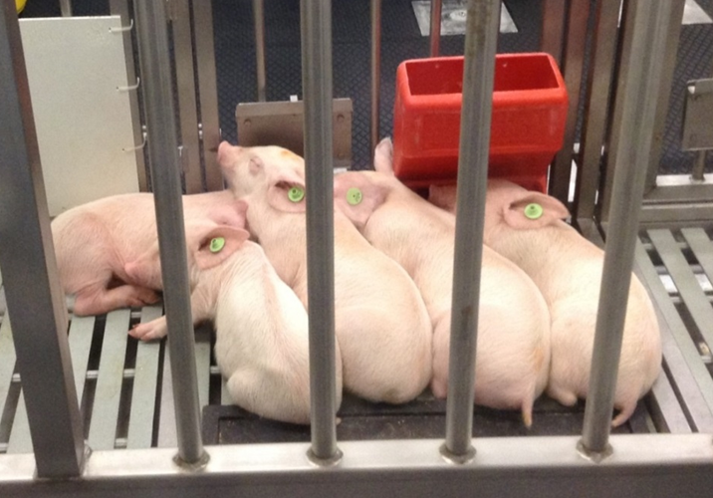
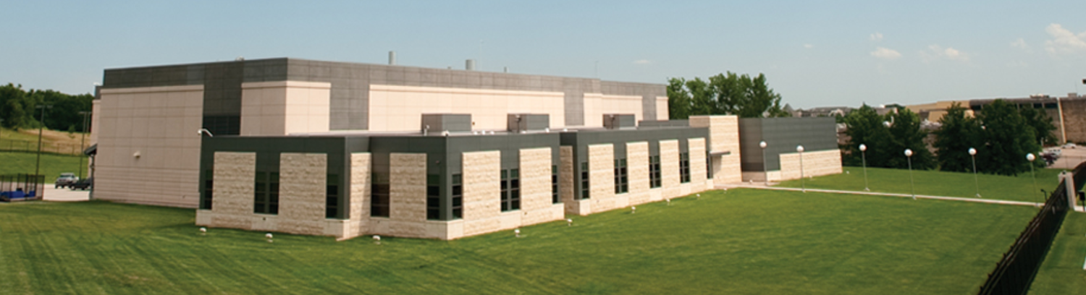
12 ASF vaccine animal studies and 320 pigs
2019-2022
ASF Viruses:
Georgia 2007 (Genotype 2)
Vietnam 2019 (Genotype 2)
OURT88/1 (Genotype 1)
Challenge dose: IM, 0.1-100 HAD50
Experimental Vaccines:
DNA vaccines
Subunit vaccines
Gene-deleted mutants
Live attenuated viruses
Objectives of Animal Studies
ASFV virulence titration
Vaccine safety
Vaccine efficacy
Pigs:
3-6 weeks old, female, from commercial farms
Biosecurity Research Institute, Kansas State University

Slide 3
Is ASFV OURT88/1 more virulent than ASFV Vietnam19?
Challenge dose: 100 HAD50/pig; IM/contact = 1/2; 10 weeks old pigs
2/6 pigs survived (DPC21) the IM challenge with ASFV Vietnam19 (Ct35 & Ct39);
0/6 pigs survived (DPC21) the IM challenge with ASFV OURT88/1.
4/12 pigs survived the contact challenge with ASFV Vietnam19. ASFV viremia in these pigs were very low (Ct34-38) on DPC21.
4/12 pigs survived the contact challenge with ASFV OURT88/1. However, ASFV viremia in these pigs were very high (Ct19-20) on DPC21.

Slide 4
Experimental Design: Subunit ASF vaccines

Slide 5
Subunit Vaccine Example #1

Slide 6
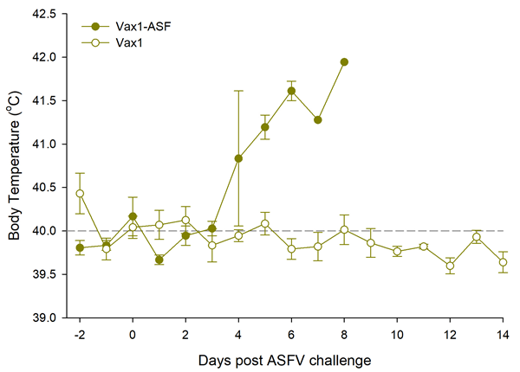
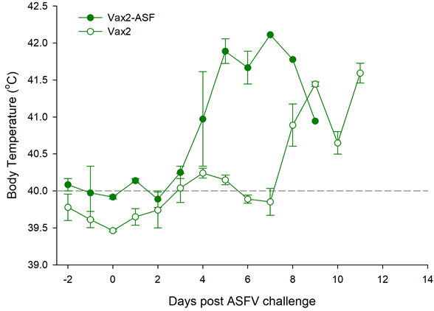
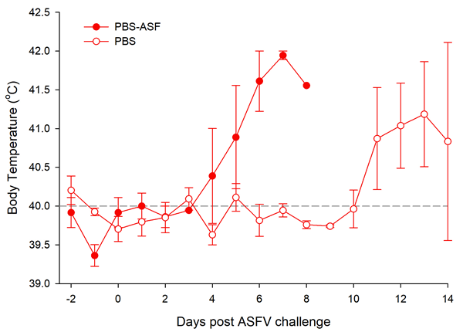
Pigs vaccinated with subunit vaccine Vax1 were protected from contact challenge with ASFV-Vietnam19

Slide 7
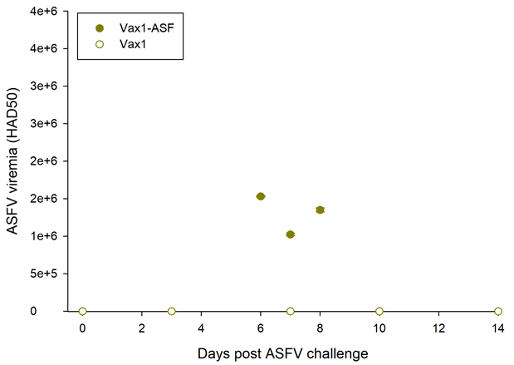
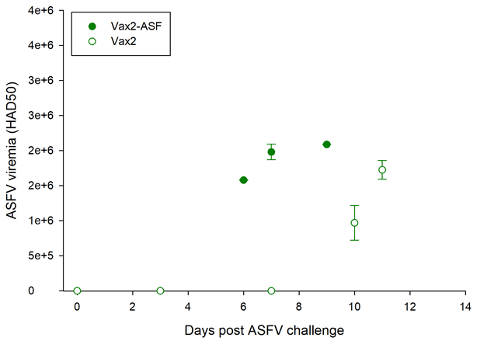
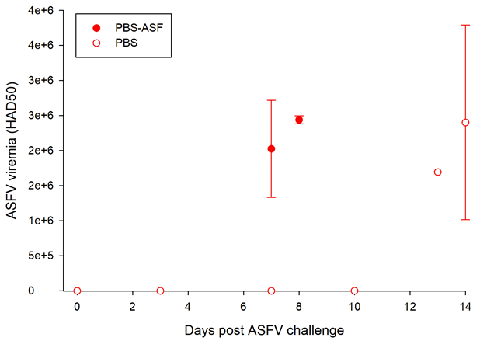
Pigs vaccinated with subunit Vax1 did not develop viremia after contact challenge with ASFV-Vietnam19

Slide 8
12 ASF vaccine animal studies and 320 pigs
2019-2022
ASF Viruses:
Georgia 2007 (Genotype 2)
Vietnam 2019 (Genotype 2)
OURT88/1 (Genotype 1)
Challenge dose: IM, 10-100 HAD50
Experimental Vaccines:
DNA vaccines
Subunit vaccines
Gene-deleted mutants
Live attenuated viruses
Objectives of Animal Studies
ASFV virulence titration
Vaccine safety
Vaccine efficacy
Pigs:
3-6 weeks old, female, from commercial farms
Biosecurity Research Institute, Kansas State University

Slide 9
What an ideal ASF vaccine should look like?
Classical swine fever vaccines
Modified live virus (MLV) vaccines: C-strain (DIVA compatible)
Subunit: E2 based subunit vaccines (DIVA)

Slide 10
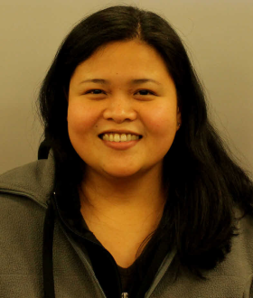
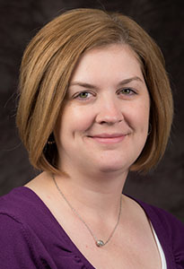

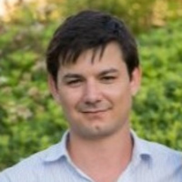
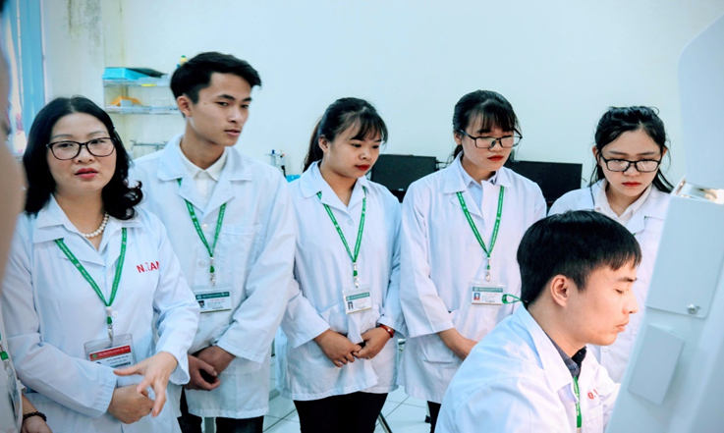
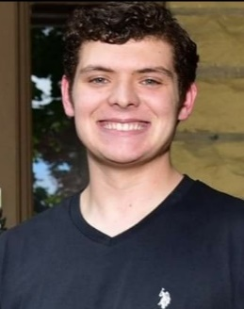
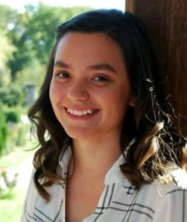
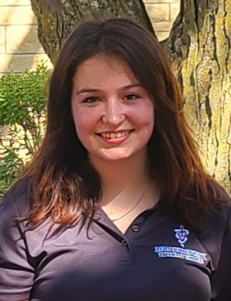
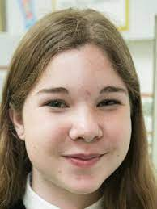
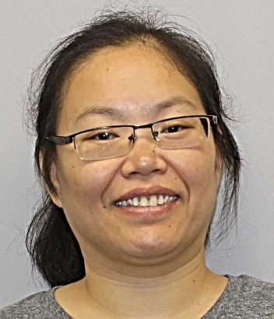
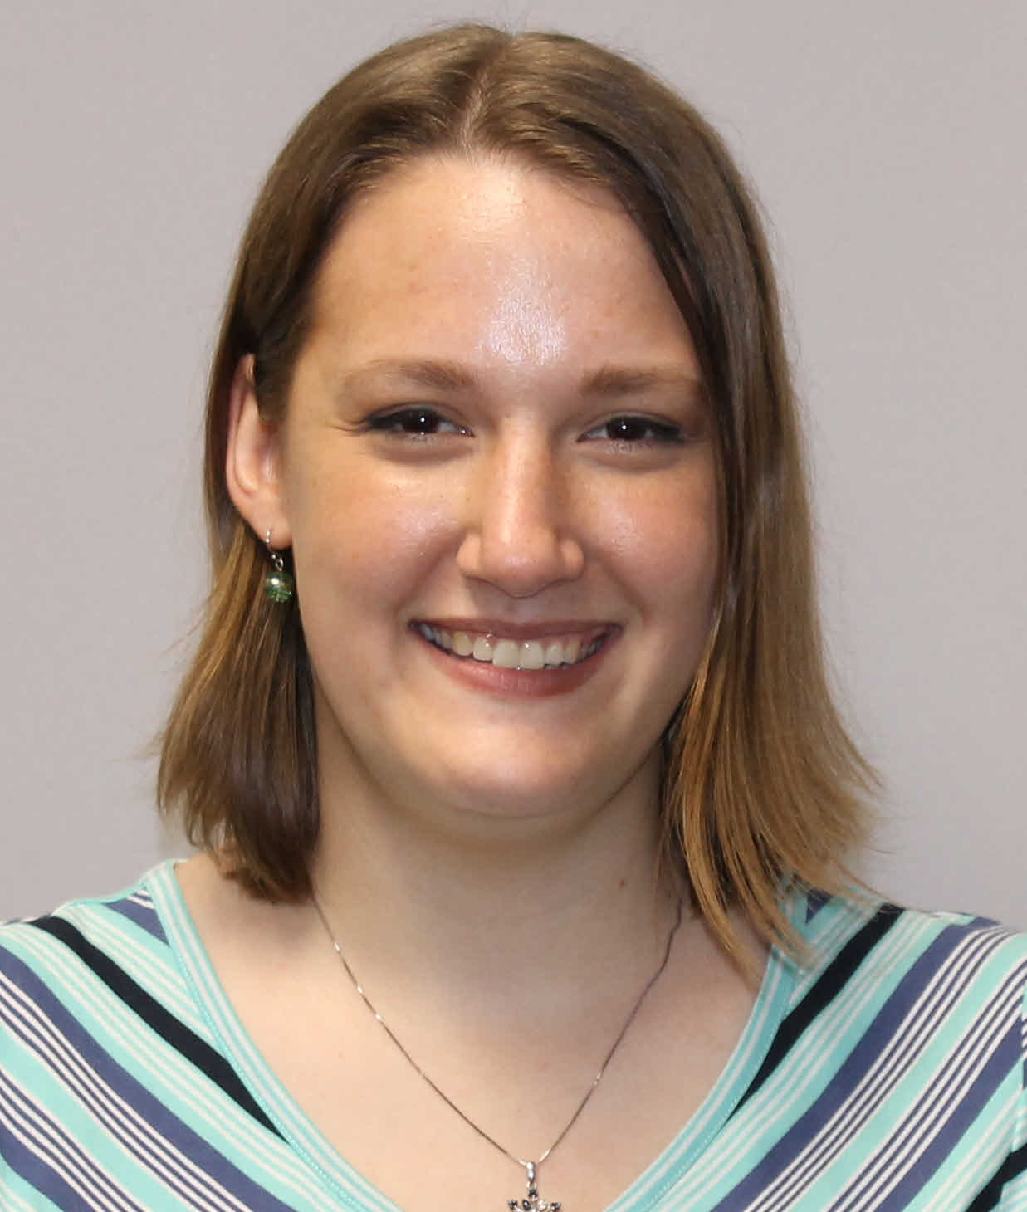
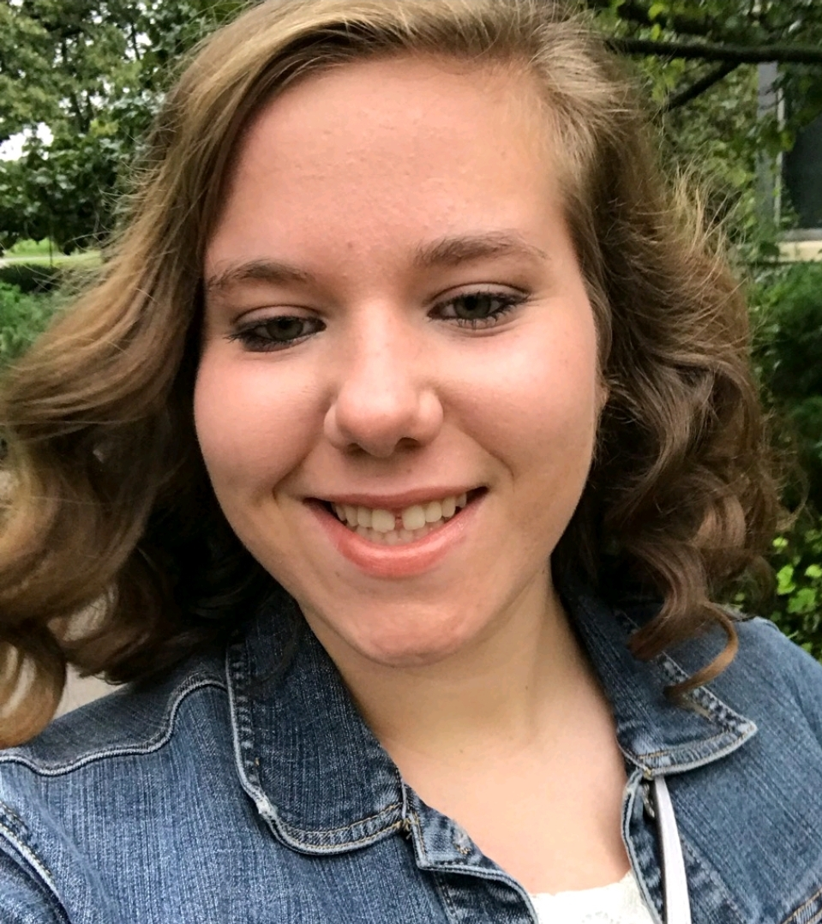
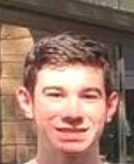
Acknowledgement
Dr. Rachel Madera
Dr. Kelli Almes
Dr. Lihua Wang
Dr. Franco Matias-Ferreyra
Dr. Quang Lam Truong at VNUA
Dr. EunJu Sohn
Dr. Hyangju Kang
Dr. Ju Hun Kim
BioApp
Dr. Ningning Ma
Dr. Jinan Huang
DingChi
Aidan Craig
Nina Muro
Jimena Kilian
Heather George
Funding Sources
(2012-2023)
NBAF Transition Fund
BioApp, DingChi
Animal Health Industry
USDA ARS, USDA FAS
USDA NIFA, DHS
Dr. Manuel Borca
Dr. Douglas Gladue
Dr. Cyril Gay
USDA ARS
Dr. Linda Dixon
Pirbright Institute
Yuzhen Li
Amanda Rezac
Isabelle Kloss
Ian Hallenbeck

Slide 11
Partnership in ASF Vaccine Development for Africa
Unmet need: Most current experimental ASF vaccines are being developed for Asian countries (genotype II)
Objective: A partnership to develop ASF vaccines specific for African countries
We are looking for partners in ASF research and vaccine development for Africa
Contact:
Jishu Shi
Professor and Director
Center for Vaccine Evaluation
College of Veterinary Medicine, Kansas State University
1620 Denison Avenue, Manhattan, KS 66506, USA
WhatsApp: +17854776977 Email: jshi@ksu.edu or jishu.shi@fao.org

Slide 12
ASF Subunit Vaccine Consortium
Members/Stakeholders: ASF vaccine researchers and sponsors
What we do: share information on ASF subunit vaccines that did not induce protective immunity in pigs
Objective: Reduce the waste of research efforts, time, and funds on ASF vaccine development
Contact:
Jishu Shi
Professor and Director
Center for Vaccine Evaluation
College of Veterinary Medicine, Kansas State University
1620 Denison Avenue, Manhattan, KS 66506, USA
WhatsApp: +17854776977 Email: jshi@ksu.edu or jishu.shi@fao.org

Slide 13

GARA 2023 Asia ASF Workshop
(Beijing, September 17-20, 2023)
The U.S.-China Center for Animal Health at Kansas State University will partner with the Global African Swine Fever Research Alliance (GARA) and Chinese Veterinary Drug Association (CVDA) to host the GARA Scientific Workshop in Beijing on September 17-20, 2023. This ASF workshop is supported by a grant from the USDA Foreign Agriculture Service (FAS) and USDA Agricultural Research Service (ARS).
The objective of this workshop is to provide a platform for the best ASF researchers around the world to get together and share their knowledge and expertise on ASF control and prevention. Working with GARA, CVDA, and USDA ARS, we plan to invite 20 ASF researchers from China and 20 ASF researchers outside China. The attendees will meet in Beijing to:
discuss ASF Research in China/Asia and around the world, and identify knowledge gaps and opportunities for future collaboration;
share the lessons and experiences learned from China and other Asian countries, especially
  what we would do differently in the last fours years had we known in July 2018 how ASF would spread in China/Asia?
  what types of research are needed in order to have more effective tools and resources for ASF control and prevention in Asia, Africa, and Europe?
foster ASF research collaborations among meeting attendees in areas of vaccine development, diagnostic tool evaluation, and epidemiology training.

